Slide 1

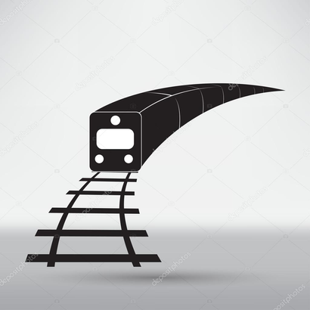
ELIZABETH LINE (Crossrail)
A strategic recommendation-focused presentation, supported by tools and a tailored project management plan.
Our Team:
Joshika (5597768), Siqi (5631449), Chengfeng (5609011), Nishika (5664610), Zezheng (5624380)

Slide 2


01 | Project Brief
02 | WBS Analysis – Identifying Problem zones
03 | Problem Diagnosis
04 | Solution Tools and Frameworks
05 | Methodology Alignment
06 | Conclusion
Agenda

Slide 3
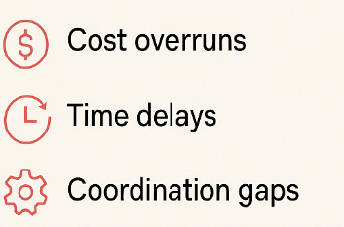
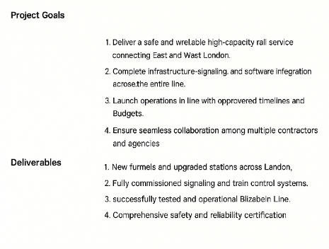
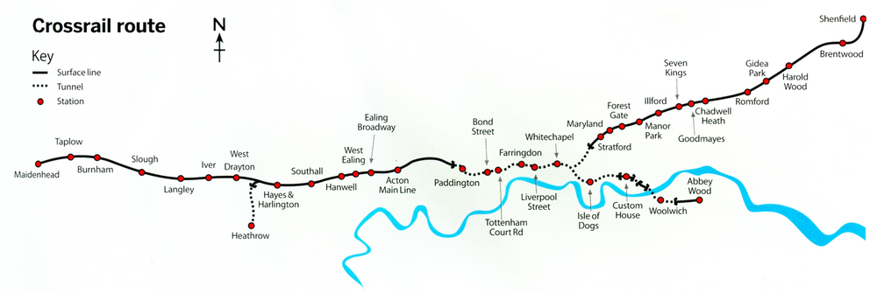
Project Brief
Our Focus
Implementation phase
Crossrail is one of Europe's largest railway infrastructure projects, aimed at improving rail capacity, connectivity, and travel times across London. The project involved the construction of 42 km of new tunnels and the integration of new and existing rail systems to deliver the Elizabeth Line
Notes:
While the project vision and outcomes were ambitious and highly beneficial, the implementation phase was where significant challenges emerged.
In this presentation, we focus specifically on cost overruns, timeline delays, and coordination gaps that occurred during this phase. We’ve studied these issues using project management tools and propose practical solutions based on our analysis.”

Slide 4
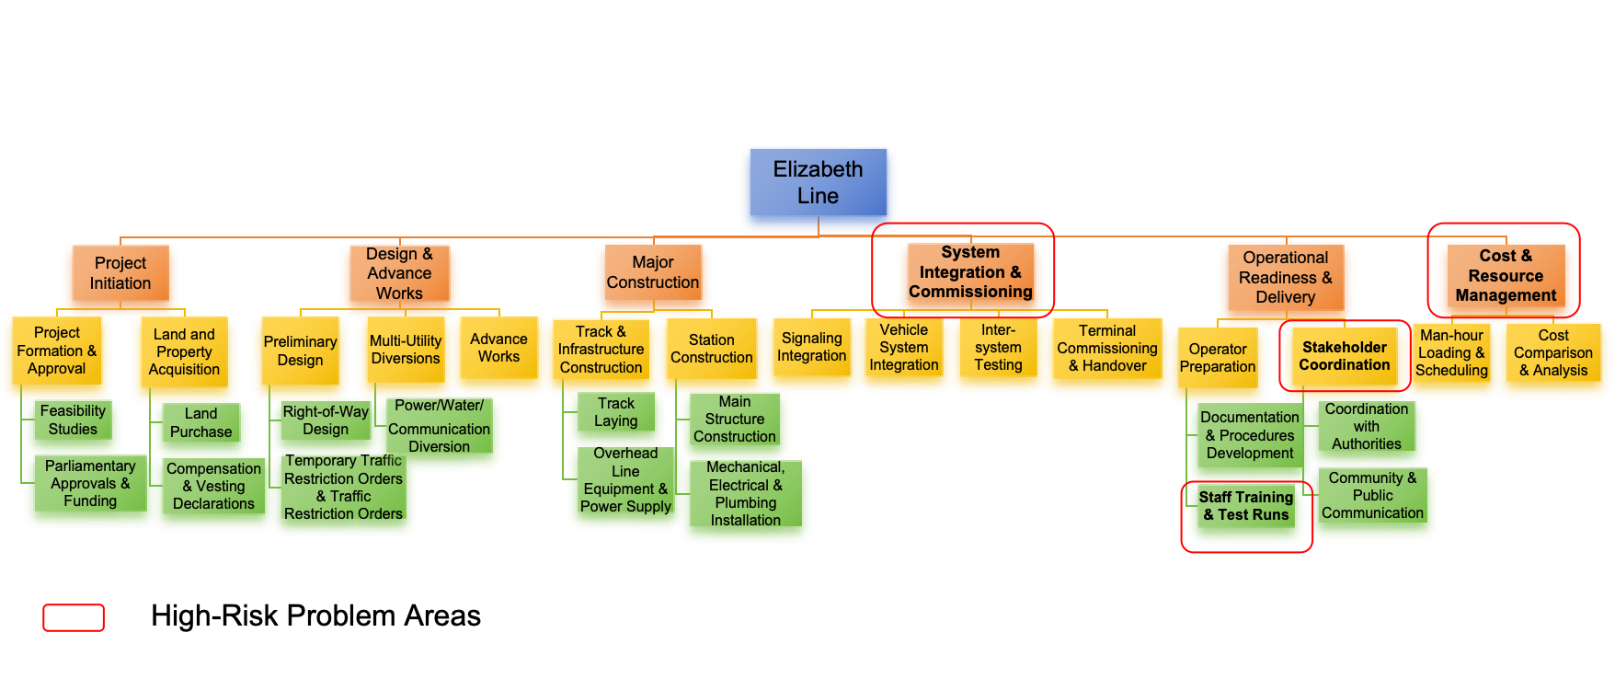
Work Breakdown Analysis – Where Did It Go Wrong?

Slide 5
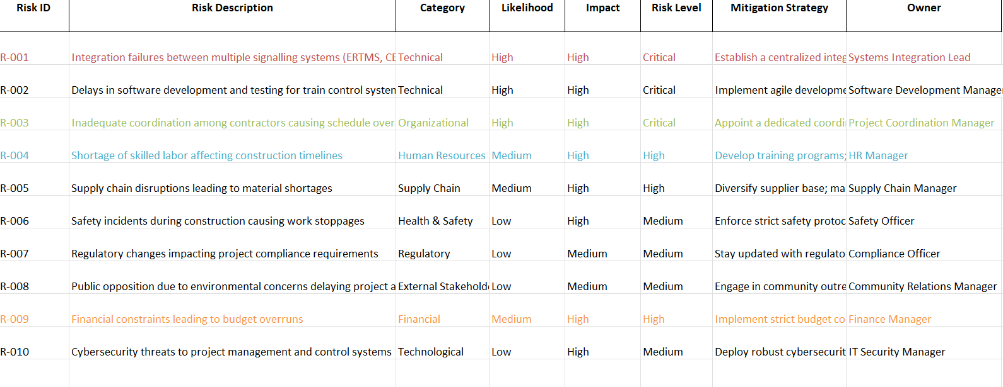
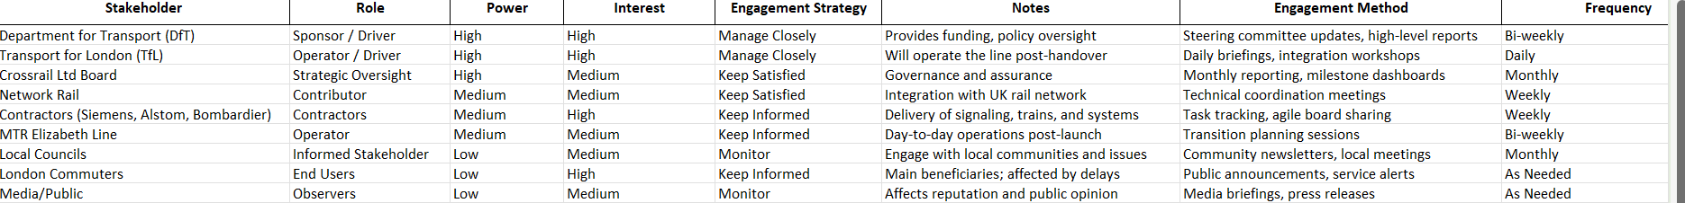
PROBLEM DIAGNOSIS
---What should be improved
Risk Register
Tools Referenced:
Risk Register (High-priority risks)
Stakeholder Register (Misalignment shown in strategy mismatch)
SWOT Analysis
2. Stakeholder Register

Slide 6
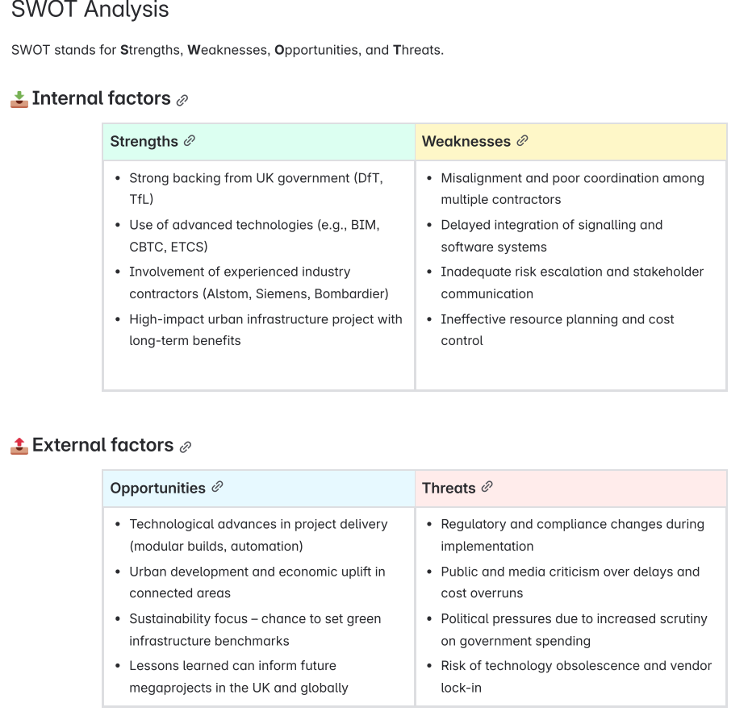
PROBLEM DIAGNOSIS
---What should be improved
3. SWOT Analysis
🔴 Problem 1: Contractor Misalignment
The lack of effective coordination mechanisms among multiple contractors leads to inconsistent schedule and standards.
🔵 Problem2: System Integration Delays
The lack of early planning tests and phased joint debugging resulted in repeated failures of key systems in the later stages of delivery.
🟠 Problem 3: Resource Scheduling Gaps
Resource and task scheduling are not dynamically coordinated, resulting in multiple path resource contention and scheduling conflicts.
🟣 Problem 4: Delayed Risk Response
Major risks were not reported in time, the handling process was unclear, and responsibilities across different management levels were poorly defined.
📊 Tools Referenced:
✔️ Risk Register (High-priority risks)
✔️ Stakeholder Register (Misalignment shown in strategy mismatch)
✔️SWOT Analysis

Slide 7
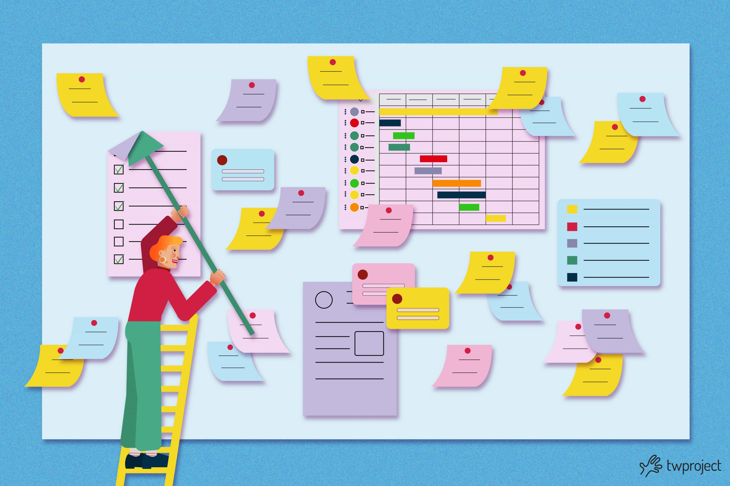
Solution Tools & Frameworks – Practical Fixes
Agile (Scrumban-lite )
Problem Area
Contractor Misalignment
System Integration Delays
Solution Tool/ Framework
RACI Chart + IPD Principles
Agile (Scrumban-lite)
Purpose
Clarify roles, promote shared accountability
Allow iteration, early feedback loops
Resource Bottlenecks
Delayed Risk Response
CCPM Buffers + Resource Histogram
Risk Breakdown Structure + Escalation
Prioritise critical tasks, apply buffer management
Structured early warning and reaction path

Slide 8
Conclusion
A tailored hybrid methodology combining predictability, flexibility, collaboration, and risk control
Workstreams/ Challenges
Civil-works & Safety-Focused Construction
Testing & Integration
Best-Fit Methodology
Waterfall / Stage-Gate
Scrumban-lite (One of Agile PMM)
Why Is It
Providing the rigorous structure and predictability essential for fixed-scope elements
Providing rapid feedback loops for complex and interdependent systems
Multi-Party Collaboration
Timeline Managment
Integrated Project Delivery (IPD)
Critical Chain Project Management (CCPM)
Alignment of contractors, sharing risk and reward to improve transparency and efficiency.
Using buffers to absorb uncertainty and ensure smooth task flow

Slide 9
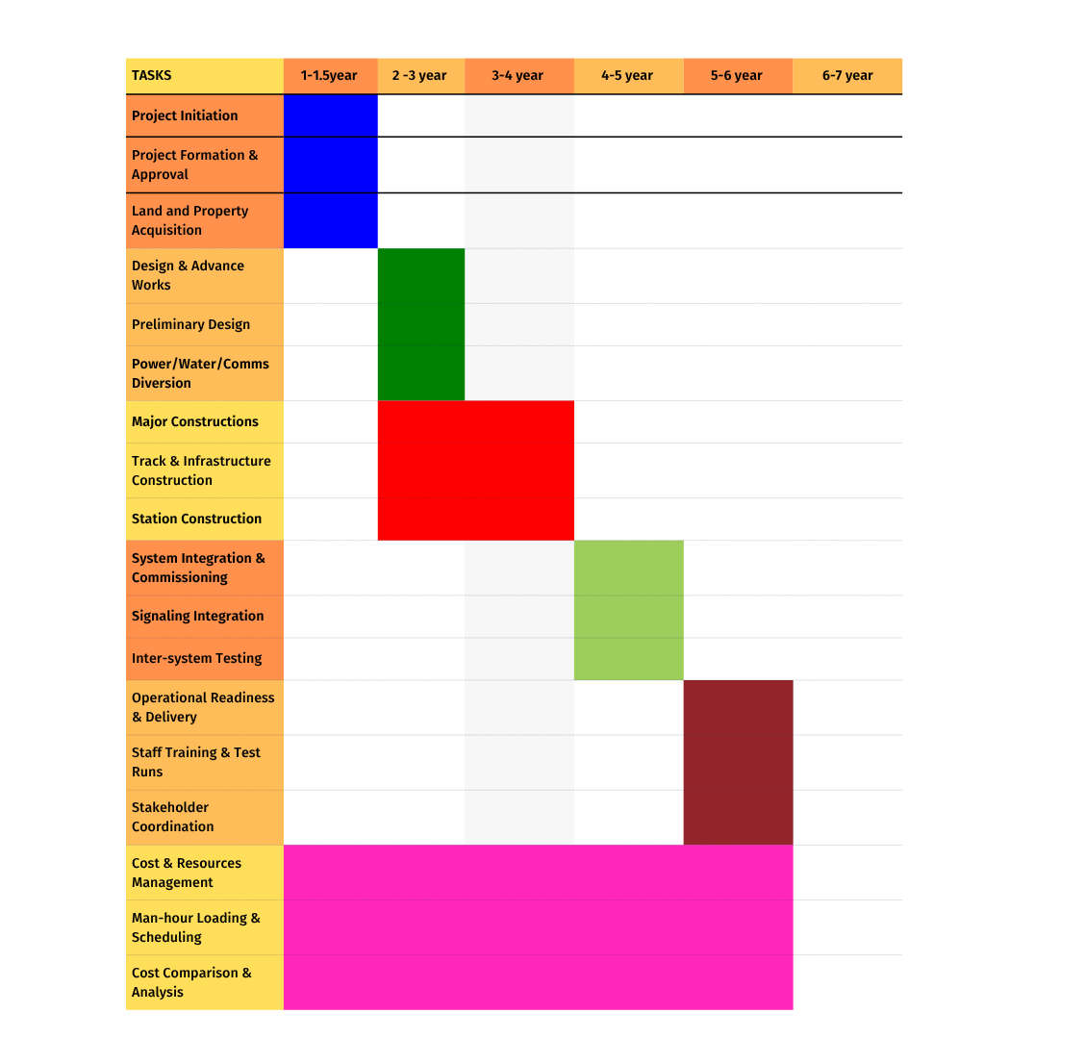
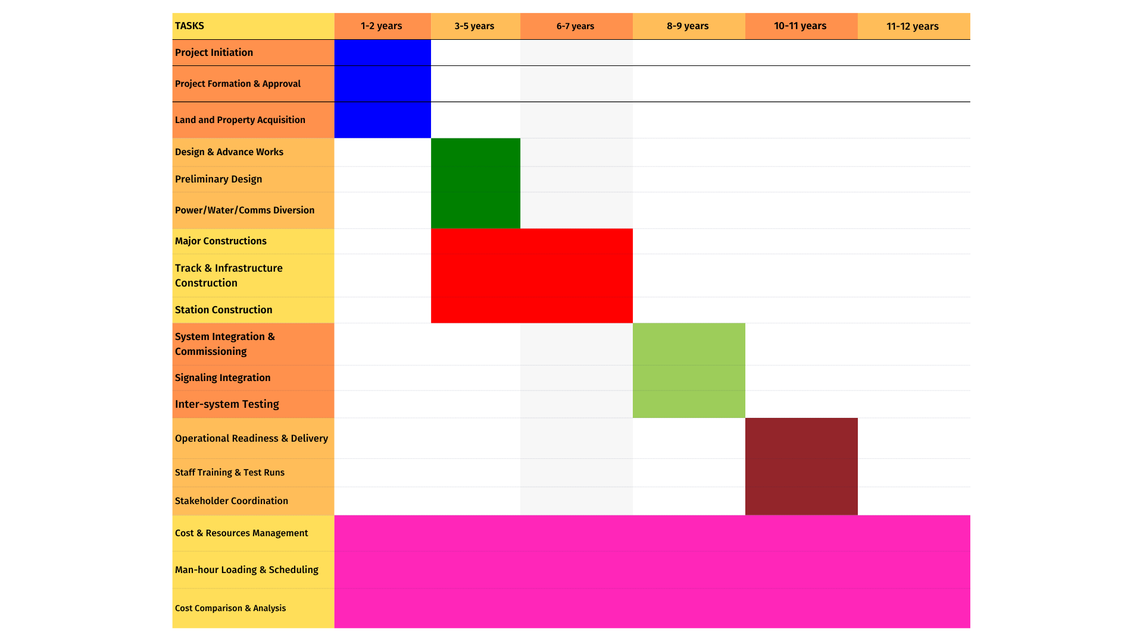

Elizabeth Line – Recommended Gantt chart by phase

Slide 10
Our Formula For Smarter Implementation:
Waterfall backbone (Stage Gate), Agile for integration tasks,
IPD (Delivery approach) + CCPM as horizontal enablers

Slide 11
Many thanks for your listening!

